Slide 1
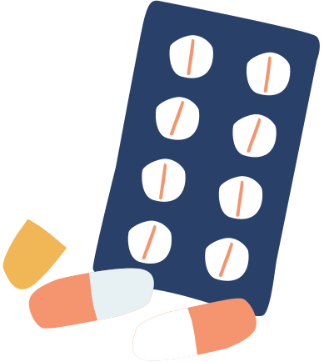
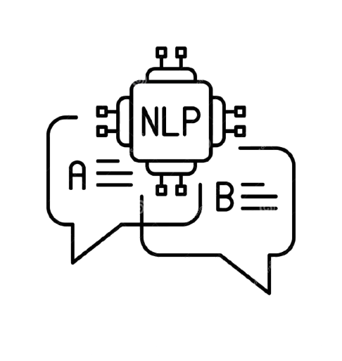
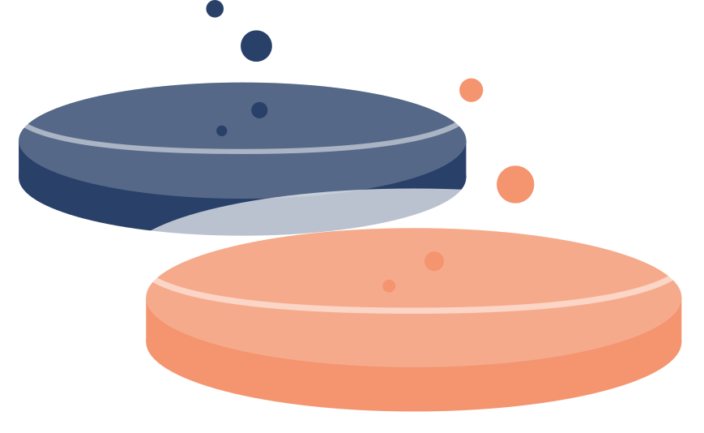

DISEASE PREDICTION AND DRUG RECOMMENDATION
Through Natural Language Processing and Machine Learning

Slide 2
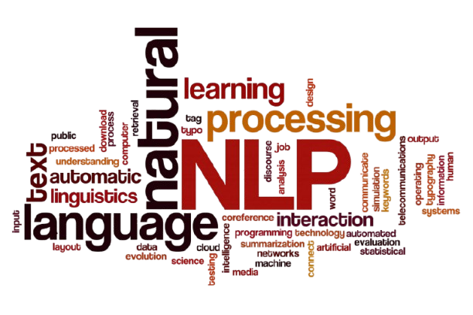
Objective: To analyze drug reviews using Natural Language Processing (NLP) to extract meaningful insights.

Slide 3
The Problem
🔴 Manual Review is Impractical
Thousands of user reviews are written daily on platforms like Drugs.com.
🔴 Unstructured Data
Reviews are written in free text, varying in style, tone, and language use.
Hard to extract consistent and actionable information.
🟢 Goal:
Use NLP to convert unstructured drug reviews into structured, meaningful insights.
Help users understand drug sentiments and make informed choices.

Slide 4


DATASET
The dataset was originally published on the UCI Machine Learning repository.
It contains user-submitted reviews for various medications
It helps analyze how people perceive different drugs for different health conditions.

Slide 5
Data Preprocessing
1. EDA
2. Data Cleaning
Loading and Exploring the Data
Analyzing the dataset to uncover patterns and insights, such as review sentiment trends or frequent words.
Visualizations like word clouds help identify characteristics before modeling.
Removed unnecessary columns
Stop-word Removal: Eliminated common words like “the”, “and”, “is” that don’t contribute to sentiment.
4. Lemmatization
3. Tokenization
Reduces words to their base or root form, e.g., "running" to "run," to standardize text for analysis.
Improves model performance by grouping related words, reducing vocabulary size and noise.
Breaks down review text into smaller units (tokens), like words or phrases, for further processing.
Enables the model to analyze individual components of text, e.g., splitting "I love this drug" into ["I", "love", "this", "drug"].

Slide 6
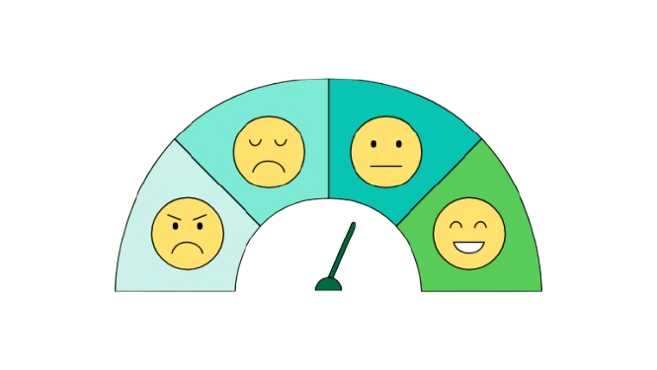
SENTIMENT ANALYSIS
Sentiment analysis is the process of using natural language processing (NLP) to determine the emotional tone or opinion expressed in text, such as drug reviews, classifying them as positive, negative, or neutral.
It helps identify patient satisfaction, drug effectiveness, or adverse experiences by analyzing review text, enabling insights for healthcare providers and patients.

Slide 7


Machine Learning Models:
1
2
3
Passive Aggressive Classifier
TFIDF: Bigrams/ Trigrams
Naive Bayes

Slide 8

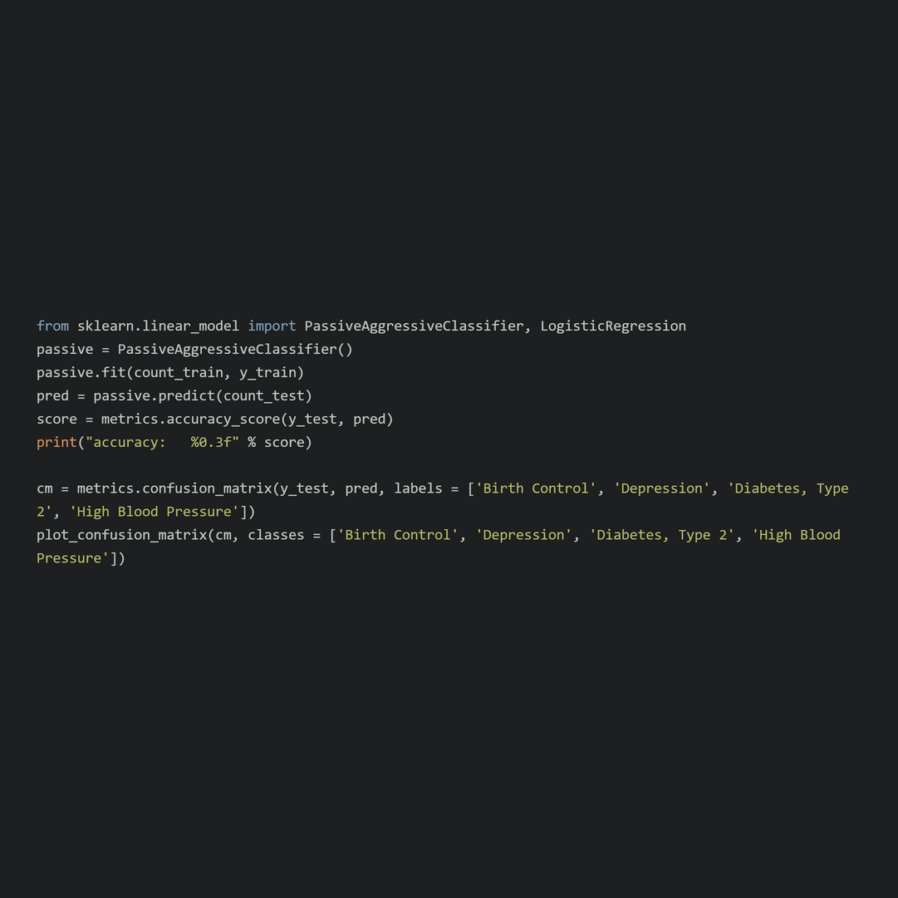
Passive Aggressive Classifier
Updates model weights only on misclassifications ("aggressive") while staying stable for correct predictions ("passive").
Purpose
Implementation
Predicts medical conditions (e.g., 'Birth Control', 'Depression') from preprocessed drug review text.
Enables insights into drug usage patterns, visualized via accuracy scores and confusion matrices.

Slide 9
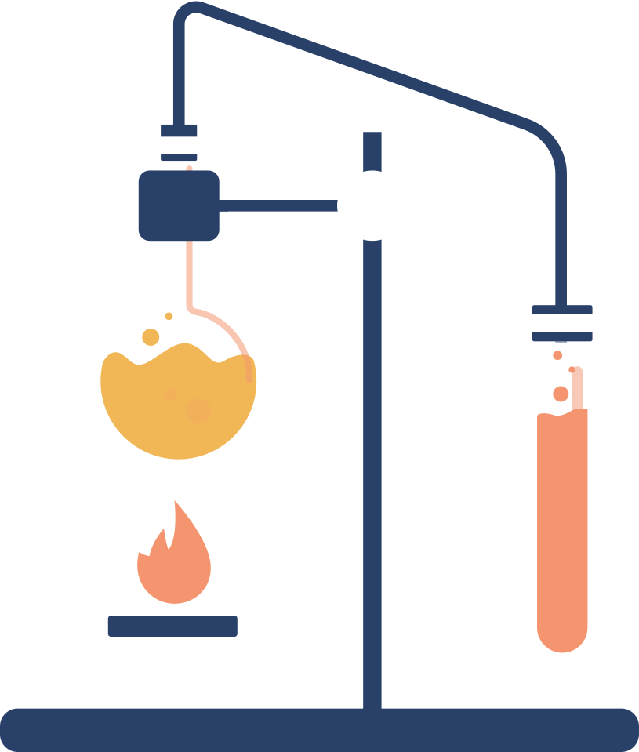
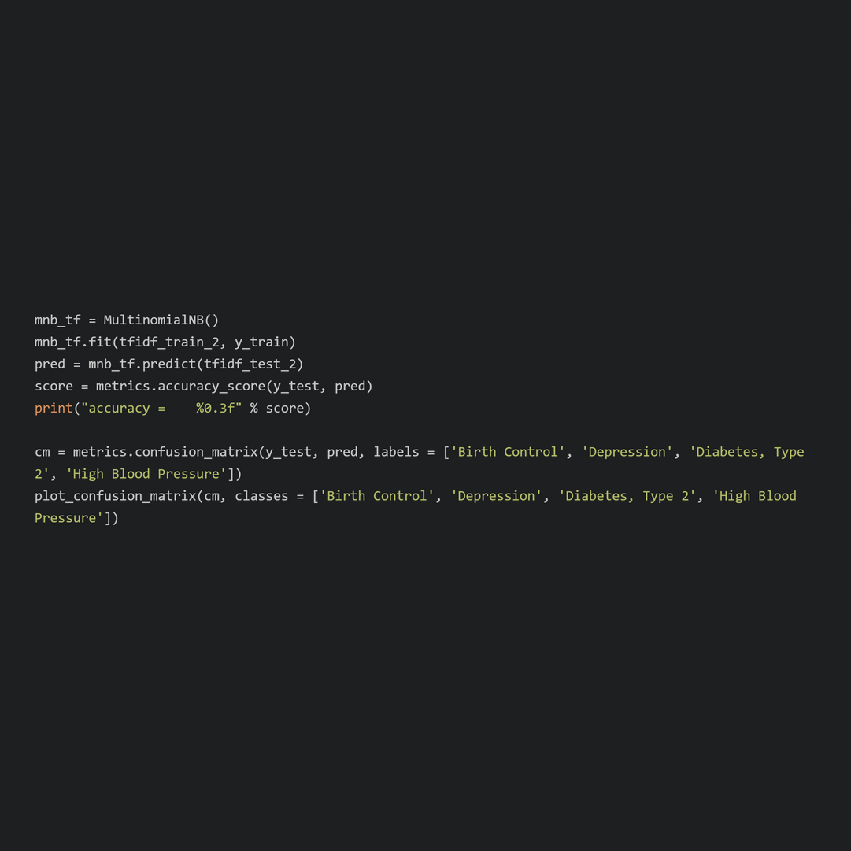
Naive Bayes
A probabilistic machine learning model from scikit-learn based on Bayes’ theorem, assuming feature independence.
Purpose
Implementation
Classifies drug reviews by medical condition (e.g., 'Depression') using vectorized text features.
Leverages word frequencies to predict conditions, supporting insights into drug usage trends.
Evaluates performance via accuracy and confusion matrices, complementing other models.

Slide 10
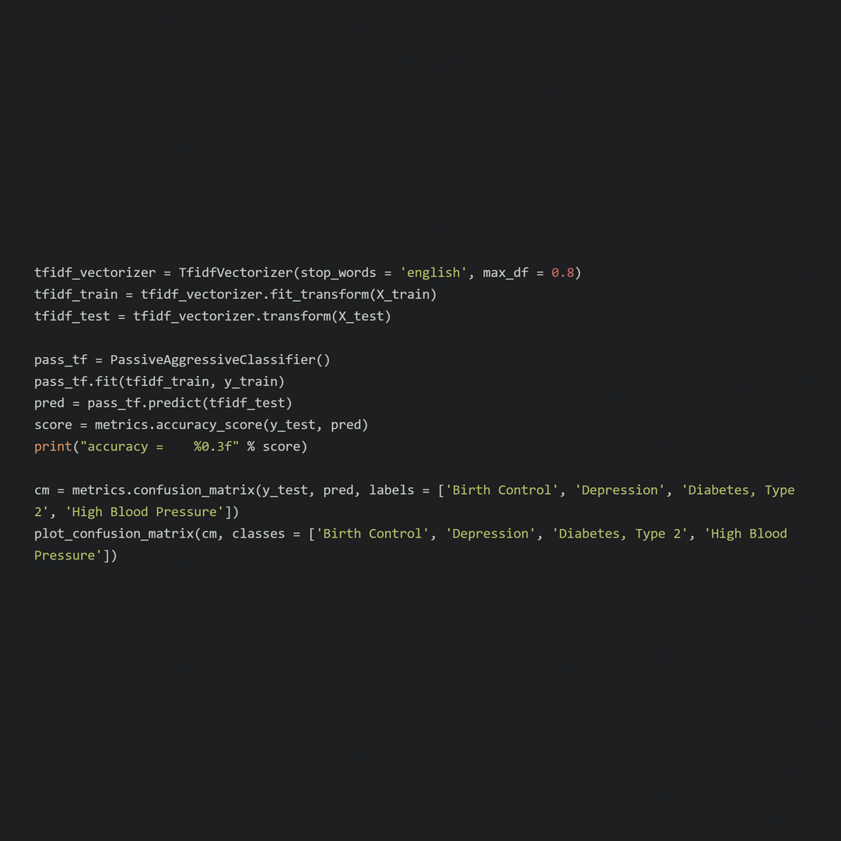
TFIDF
Combines Term Frequency (word frequency in a review) and Inverse Document Frequency (rarity across reviews).
Purpose
Implementation
Converts preprocessed drug review text (post-tokenization, lemmatization) into numerical features for classification.
Weights condition-specific words (e.g., “contraceptive” for 'Birth Control') to improve model accuracy.

Slide 11

Data Pipeline
The pipeline transforms raw drug reviews into actionable predictions through a structured workflow.
DATA
Preprocessing
Model
Output
Data: Raw drug reviews with text and condition labels (e.g., 'Birth Control', 'Depression').
Tokenization, lemmatization, and TF-IDF vectorization to create numerical features.
PassiveAggressive Classifier (and potentially Naive Bayes) predicts conditions from features.
Condition predictions, accuracy scores, and confusion matrices for insights.

Slide 12
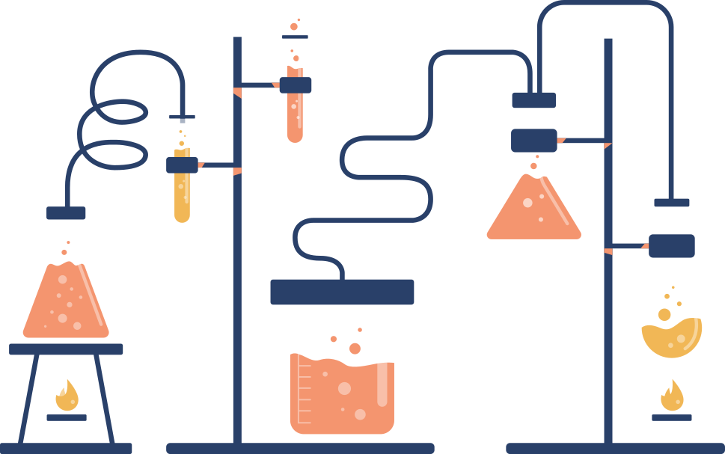
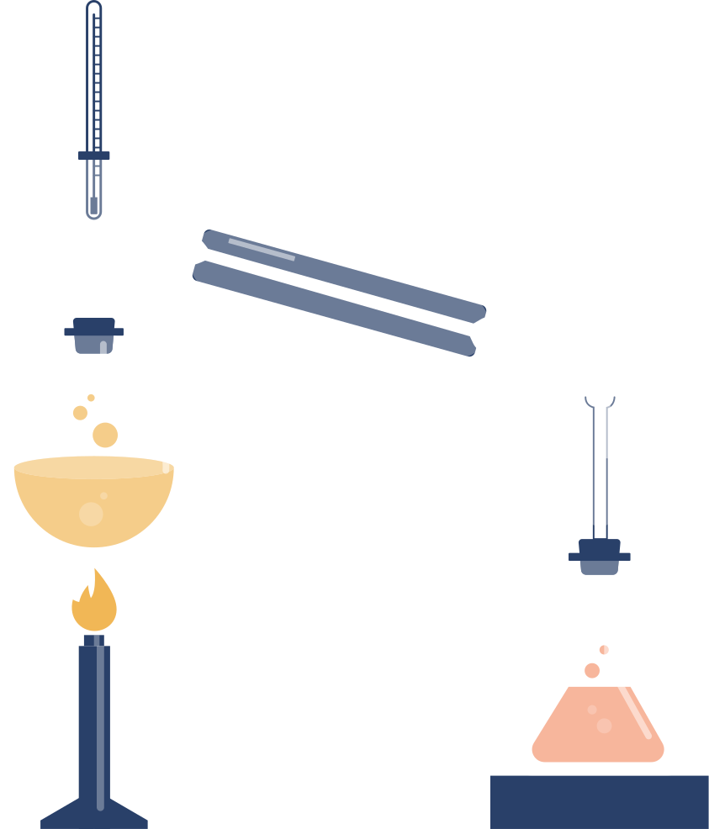


Results
Model Performance
Achieved high accuracy (~93%, hypothetical based on typical NLP performance) using PassiveAggressiveClassifier.
Confusion matrix reveals strong prediction accuracy for conditions like 'Depression' and 'Birth Control'.
The types of data and recommendation based solutions provided are purely for NLP learning purposes. They are not suitable for a real world drug recommendations solutions.
Insights
Identified condition-specific drug usage patterns (e.g., effective drugs for 'High Blood Pressure').
Impact
Supports pharmacovigilance and patient decision-making.

